Slide 1
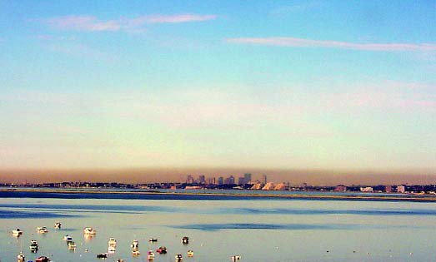
Impact of diesel vehicle traffic on ambient black carbon concentrations in Port Richmond
Michelle c. kondo, ph.d.
Postdoctoral Research Fellow
School of Social Policy & Practice
University of Pennsylvania
Collaborators:
Clean Air Council (Chris Mizes, John Lee), Dr. Igor Burstyn (Drexel Environmental & Occupational Health), Dr. Peter DeCarlo & Dr. Michael Waring (Civil & Architectural Engineering)
http://www.epa.gov/pm/health.html

Slide 2
Overview
Regulatory Background
Diesel Exhaust Particles
  Sources & health concerns
Local Policy Background & Significance
  Built environment, planning
  Goods movement
Pilot Studies Process & Results
Challenges & Next Steps

Slide 3
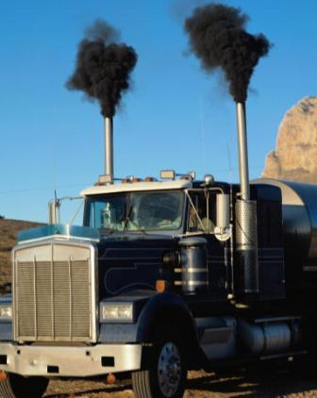
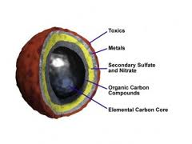
PM Sources and
Diesel Exhaust Particulates (DEP)
Common sources: Fuel-burning engines, industry, wood burning, cigarettes
Largest PM source: diesel exhaust
DEP health effects from surface
chemicals & metals
http://www.michigandieselcleanup.org
Notes:
(i.e. power plants, incinerators)
Diesel engines emit up to 100 times more exhaust PM than gas engines
black carbon in the air actually absorbs sunlight as it comes from space, directly heating up the atmosphere. "The soot particles are like the parts of a blanket, and it's getting thicker," says Ramanathan. "The smoke absorbs sunlight and heats the blanket directly."
Read more: http://www.time.com/time/health/article/0,8599,1938379,00.html#ixzz2CdfB7jZW

Slide 4
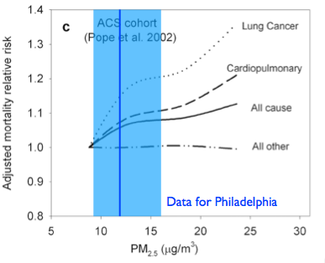
PM Exposure’s Health Effects
Asthma and respiratory disease
Cardiopulmonary mortality
Low birth weight and preterm birth
Chart source: Peter DeCarlo, based on data from Harvard Six Cities (Dockery et al. 1993); ACS (Pope et al. 2002, 2004)

Slide 5
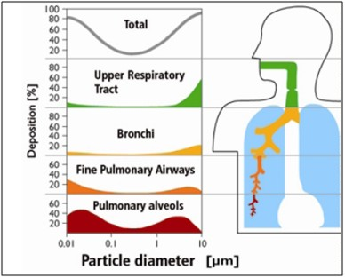
Pediatric Asthma
1980 - 2010 asthmatic children in US increased from 2.3 - 7 million (CDC 2010)
Sharpest increases in
children under 5, in
urban areas & among
poor, and non-white
Source: ICAO Information Paper CAEP-SG/ 20082-IP/05
Notes:
Over 10 million U.S. children aged 17 years and under (14%) have ever been diagnosed with asthma; 7 million children still have asthma (10%).
+ Boys (16%) were more likely than girls (12%) to have ever been diagnosed with asthma.
+ Non-Hispanic black children were more likely to have ever been diagnosed with asthma (21%) or to still have asthma (16%) than Hispanic (13% and 8%) or non-Hispanic white (12% and 8%) children.
+ Children in poor families were more likely to have ever been diagnosed with asthma (17%) or to still have asthma (12%) than children in families that were not poor (12% and 8%).

Slide 6
Public Health Implications
Premature deaths, hospitalizations
ER visits
Health care costs
Missed work and school
Notes:
In Seattle, an increase of 11 µg/m³ fine PM associated with 11% increase in asthma ER visits
Norris et al. 1999, An association between fine particles and asthma emergency department visits for children in Seattle. Environ Health Perspect 107:489-93.
Greater than 14 million school days are missed annually by students suffering from asthma (~8 days per year for each student suffering from asthma).
~15 million work days are missed annually by adults suffering from asthma.
The annual direct health care cost of asthma is $18 billion ($10 billion for hospitalizations and $8 billion in earnings lost).
Researchers found that there was a 6- to 7-percent increase in cerebrovascular disease-related hospital visits for every 10 microgram per cubic meter (ug/m3) increase in 24-hour PM2.5 levels the prior day. In addition, there was a 6-percent increase in respiratory tract infection-related hospital visits for patients under the age of 65 for every 10 ug/m3 increase in 24-hour PM2.5 levels the prior day.
www.epi.alaska.gov/bulletins/docs/b2010_26.pdf

Slide 7
Meta-Research Questions
Where and how are people exposed to PM in urban areas?
Are there socioeconomic/racial discrepancies in PM exposure?
Are there aspects of the built/natural environment that increase/reduce PM exposure?
How can community groups be involved in air monitoring research? Does this facilitate policy solutions?

Slide 8
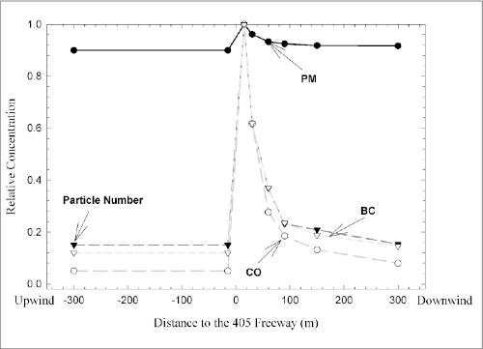
The need for local monitoring
Zhu, Y., Hinds, W. C., Kim, S. & Sioutas, C. Concentration and Size Distribution of Ultrafine Particles Near a Major Highway. Journal of the Air and Waste Management Association 52, 1032-1042, (2002).
Notes:
Air quality monitors across the U.S. are generally sited away from major roadways in order to capture ambient measurements. In Philadelphia there are ten regional air quality monitors operated
These regional monitors are insufficient to characterize pollutant composition and concentration at the local or personal level, for the purposes of policy-making.

Slide 9
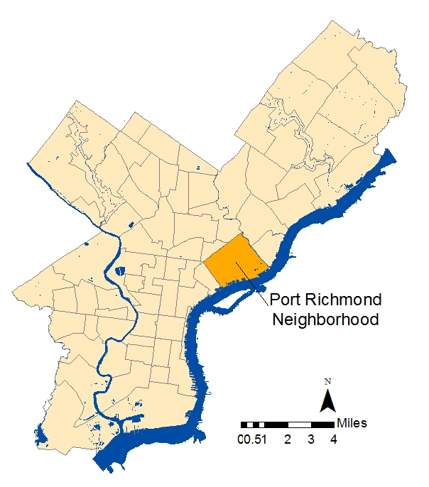
Policy Background & Significance:
Goods Movement
Expansion of the Panama Canal
Dredging of the Delaware River
➔Philadelphia’s ports: projected increase in cargo vol.
Growth in container shipping
Increasing ship size
More private participation
Clean Air Council
Notes:
Corbett announces $15M for Delaware River dredging
September 21, 2011|By Linda Loyd, INQUIRER STAFF WRITER
Gov. Corbett today announced that Pennsylvania will spend $15 million to deepen the next 4- to 5-mile stretch of the Delaware River's main shipping channel.
Flanked by Philadelphia city, port and labor officials at Packer Avenue Marine Terminal, the governor said the 103-mile dredging - which will deepen the channel to 45 feet, from 40 feet - is vital to the region to accommodate larger ships and promote commerce.
"With ports up and down the East Coast deepening their navigation channels, Pennsylvania's international seaport in Philadelphia must keep pace to remain competitive in the growing international market," Corbett told the gathering.
Growth in container shipping
95% of the world’s cargo is containerized
Containers: 20 or 40 foot standard units; caused massive increase in global trade
Ship Size: Maersk is moving to ships with 22 rows width of containers
Hubs: Norfolk, NY/NJ
Private: Ports have always been public/private, but increasingly going toward private to maximize revenue

Slide 10
Policy Background & Significance:
Built Environment
Increasing plans & policies to promote urban density
  2011: Philadelphia 2035: Draft Comprehensive Plan, zoning code revisions
  Ultrafine particles and gases from combustion highly elevated near roadways
Increased human exposure to air pollution
Notes:
Land use and transportation policies, and the design of our built environments, can significantly affect public health and the environment(Frumkin 2002; Seto et al. 2007).
States and local governments especially in areas of high population growth are increasingly enacting policies which promote compact, infill and transit-oriented development.
These policies aim to increase the efficiency of infrastructure and resource use, reduce greenhouse gas emissions, improve walkability and public health, and conserve ecologically sensitive regions within and surrounding urban areas.
In 2011, Philadelphia released Philadelphia2035: Draft Comprehensive Plan. The plan identifies seven “Industrial Legacy Areas”, one being the Central Delaware River Waterfront, which includes some areas of Philadelphia’s Port Richmond neighborhood (see Figure 1).
These areas are described as underutilized and targeted planning and zoning code revisions are aimed at broadening the types of uses in these areas, which would bring more people and activities to these areas.
An upcoming process to revise the city’s zoning code will bring this vision of increased use and access to light.
However, one study has shown that along with compact development patterns, or increased use and activities within industrial and highly trafficked areas, comes increased human exposure to air pollution(Marshall, Brauer, and Frank 2009; Schweitzer and Zhou 2010; Giles et al. 2011). Increasing human presence and activity within proximity to emissions from marine vessels is also a concern, as these vessels run on lower quality “bunker grade” diesel fuel and are subject to relatively lax emission controls.
Increasing plans & policies to promote urban density
2011: Philadelphia 2035: Draft Comprehensive Plan, zoning code revisions
Ultrafine particles and gases from combustion highly elevated near roadways (Zhu et al. 2002a,b)
Increased human exposure to air pollution (Marshall, Brauer, and Frank 2009; Schweitzer and Zhou 2010; Giles et al. 2011)
Diesel emissions contain carcinogens, toxins, particulate matter, nitrogen oxides
Asthma & respiratory infections; cardiopulmonary mortality; low birth weight & preterm birth (Brauer et al. 2002; 2007; Brunekreef et al. 2009; Hoek et al. 2002; Kim et al. 2008; Wu et al. 2009)

Slide 11
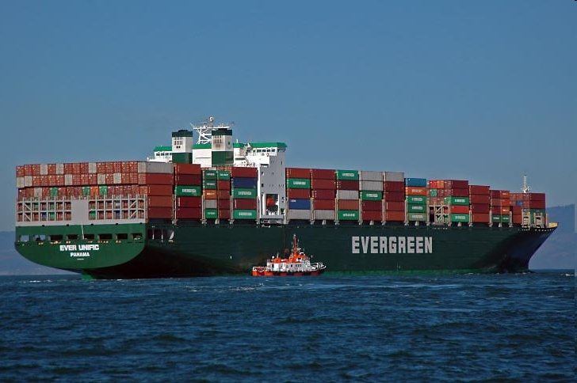
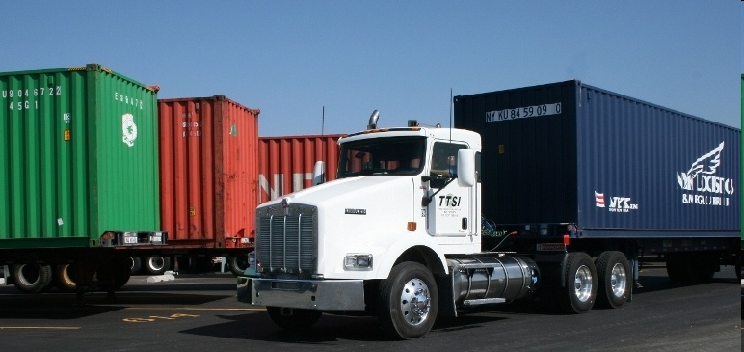
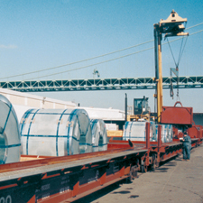
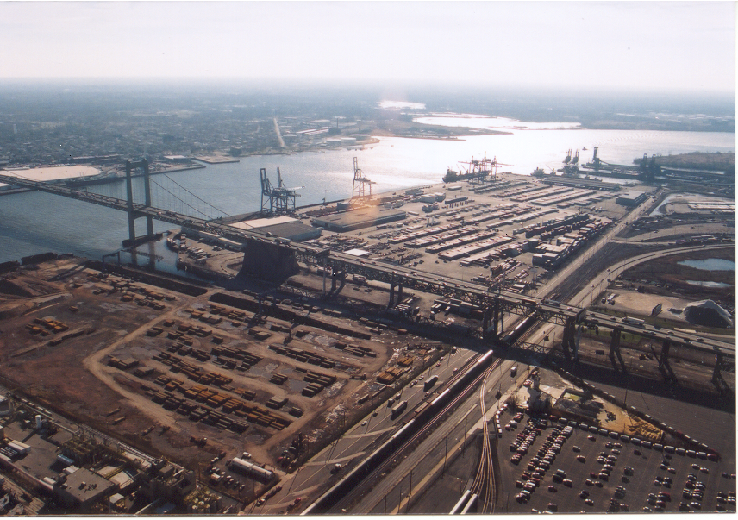
Philadelphia’s Ports & Emission Sources
Nonattainment for fine particulate matter (PM_{2.5})
10% < Philadelphia’s diesel emissions from port
Delaware River communities most burdened with hazards
Regional data ≠ local or personal exposure
Dearth of envtl data in Phila
Notes:
Second Largest Port in North Atlantic
#1 for perishables, #3 for Steel, and key entry points for cocoa and forest products
Expanding: dredging and building the southport, and a recent investment from the state of PA forecast growth for the port.
Maritime activity: ocean going vessels, tugs
Land-based-cranes
Trucks
Port development and expansion

Slide 12
Philadelphia’s Port Richmond Neighborhood
3 Marine terminals
35% at/below fed. poverty level
Asthma:
  Philadelphia: 23% children; 17% adults
  Port Richmond: 26% children; 23% adults
Resident complaints
Source: Philadelphia Health Management Corporation’s 2008 Household Survey

Slide 13
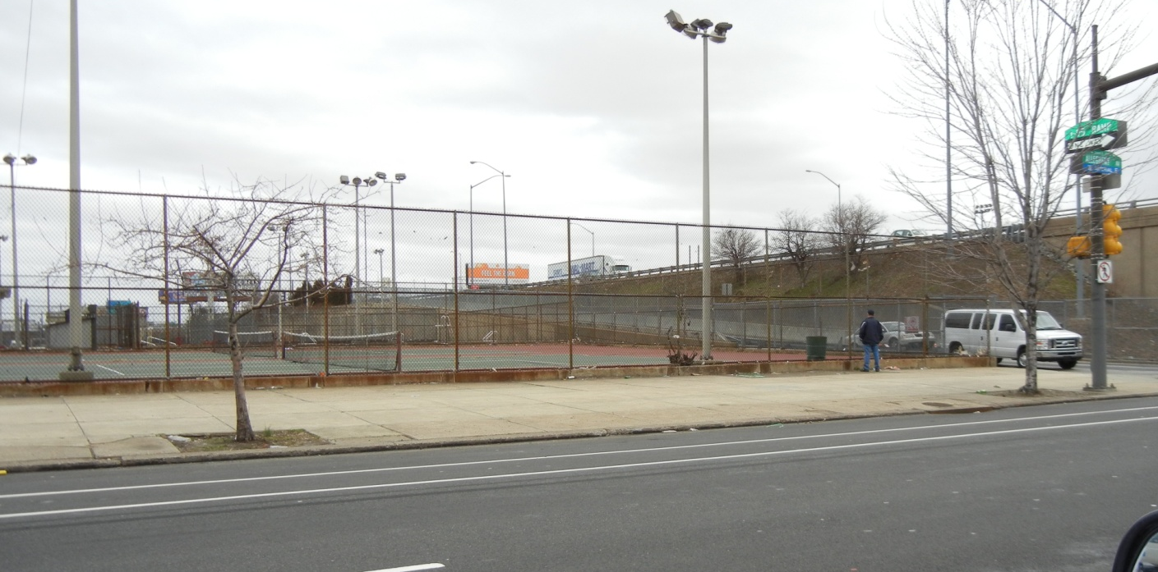
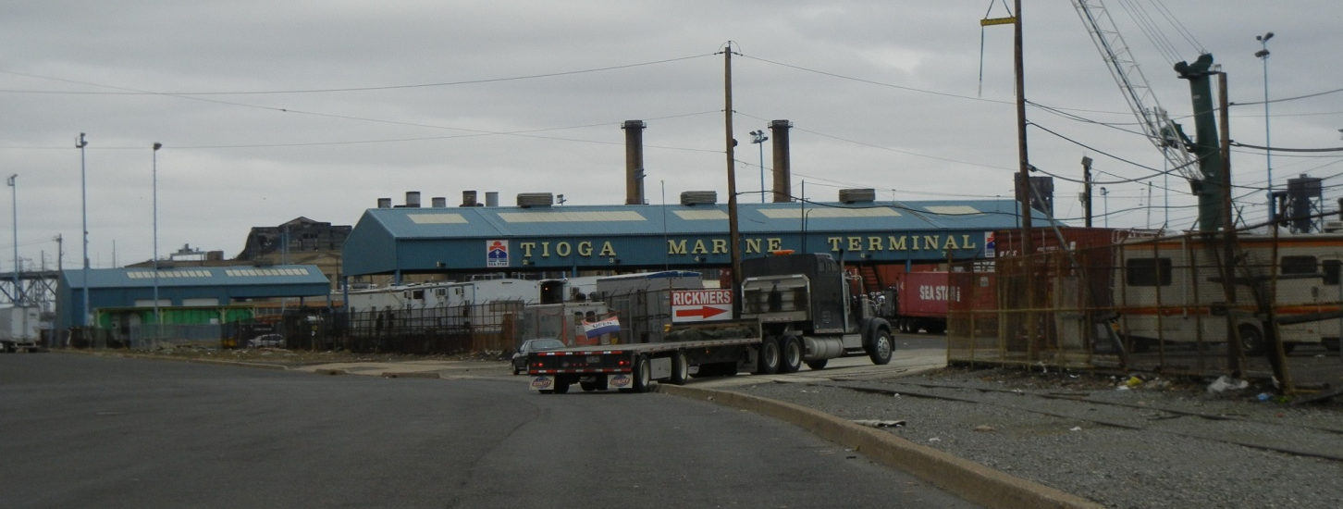
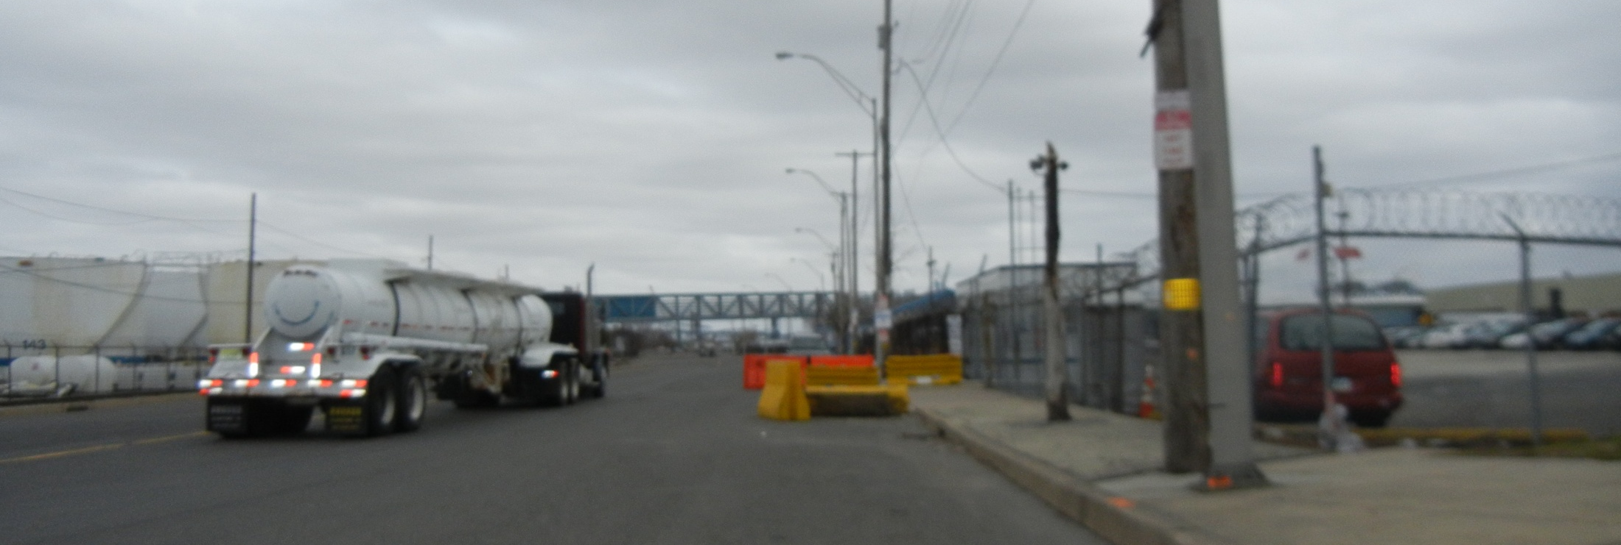
Monkiewicz Playground & I-95 offramp
Tioga Marine Terminal
Street leading to Marine Terminal

Slide 14
1. Community Outreach and Baseline Data Acquisition
Outreach & partnering with community groups
Observation, tabling or speaking at events/meetings
Informal interviews
Do you have any concerns regarding health or safety in the neighborhood? Air pollution & truck traffic?
Where are the areas of highest exposure?
January 2011 - present
Notes:
Do you have any concerns regarding air pollution in the neighborhood?
Are you concerned about the high volume of truck traffic in the neighborhood?
Where are the areas of highest exposure to air pollution, noise, or safety hazards from truck traffic?
How about for sensitive populations like children or the elderly?
Do you have any other health or safety concerns in the neighborhood?
Would you be interested in participating in a research effort to document some of these concerns and measure this exposure?
Would you be willing to wear an air quality monitor, or host one on your property?

Slide 15
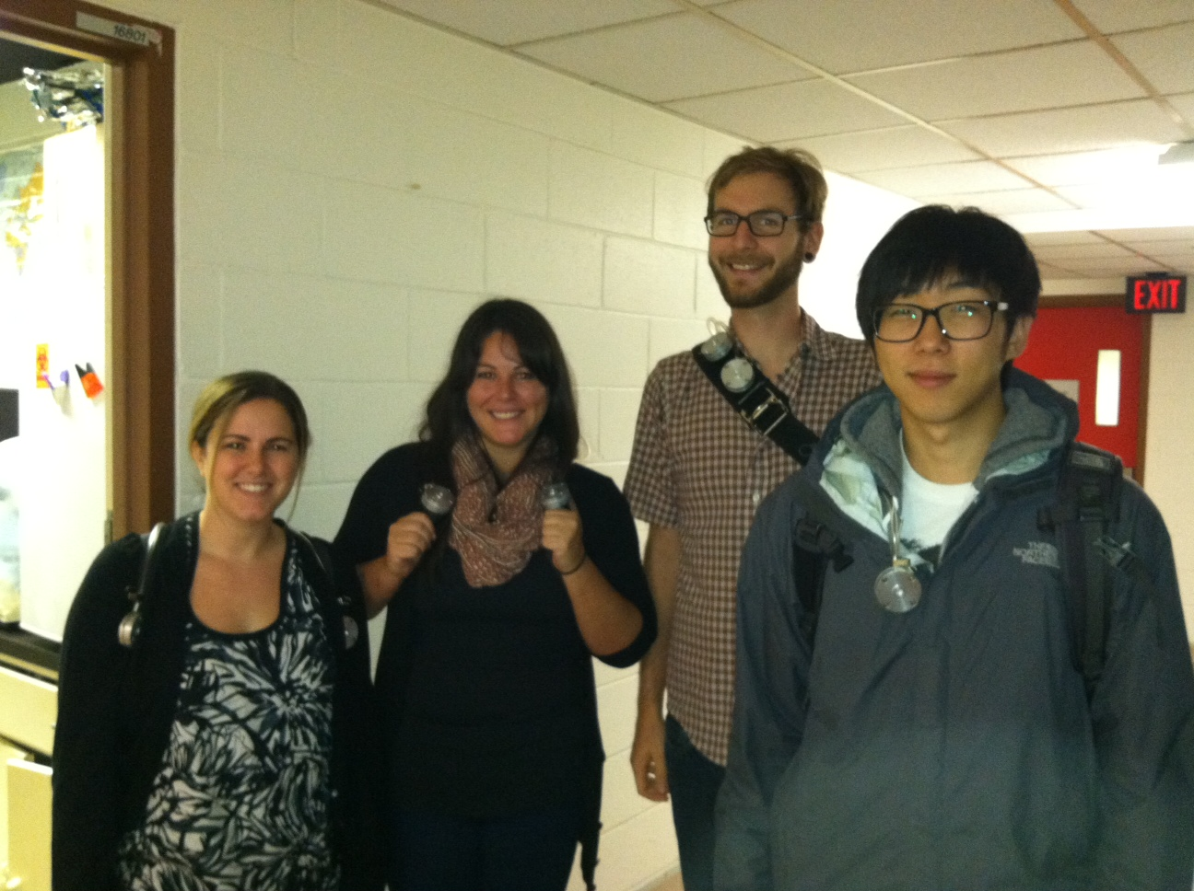
2. PM_{2.5} Personal Exposure
Monitoring (11-12 / 2011)
Participant PM_{2.5} Exposure vs.
Philadelphia Ambient Concentration
Clean Air Council
10 participants wore HPEMs
3 days
Philadelphia Air Management Services (AMS)
Photo-documentation

Slide 16
3. Black Carbon Study (June 2012)
Spatial/temporal patterns of BC in Port Richmond
Statistical models test for effects of predictive & meteorological variables:
  Traffic volumes, proximity to major roadways& other known diesel emission sources, time, temperature, wind speed and direction.

Slide 17
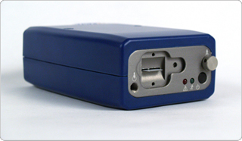
3. Black Carbon Study (June 2012)
26 unique measurements over 9 days
  5-23-12 through 6-27-12
  Repeated measures at 6 locations
17 fixed-site locations
Micro-aethelometers* (Magee Scientific)
  1-minute measurements
Traffic counts (DVRPC) on Richmond St. & E. Allegheny Ave
  8am 5-28 to 7am 6-6-12
*Thanks to Jonathan Levy, Boston U.
Notes:
Micro-Aeths determine BC concentrations by scaling measurements of light absorbtion by particles collected on a filter. Absorption of light increases as more BC mass is deposited on the filter.

Slide 18
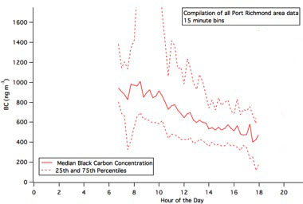
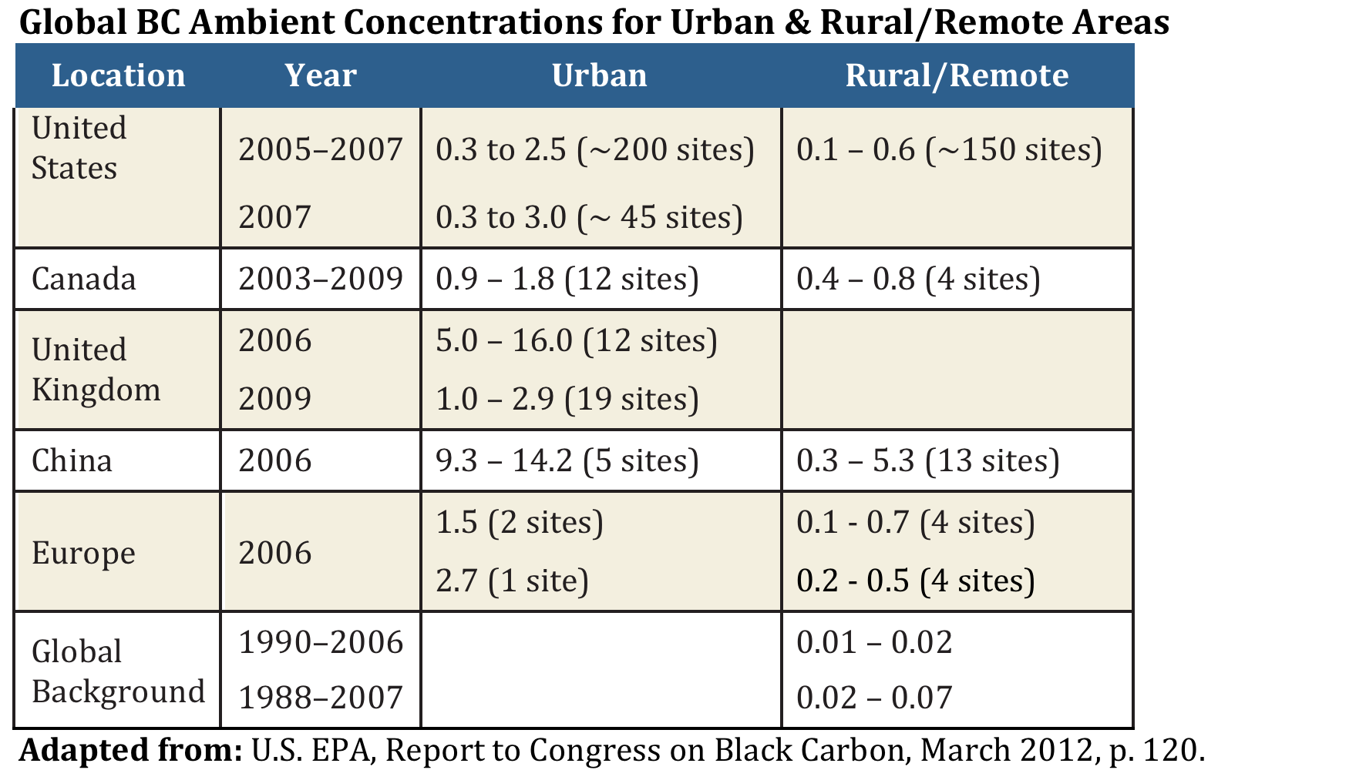
3. Black Carbon
Study Results
Range*: 0.4 – 3.0 µgm⁻³
Avg: 1.2 µgm⁻³
Max: 12 µgm⁻³
Higher in a.m.**
*Based on 30-minute boxcar averages **(p<0.0001)

Slide 19
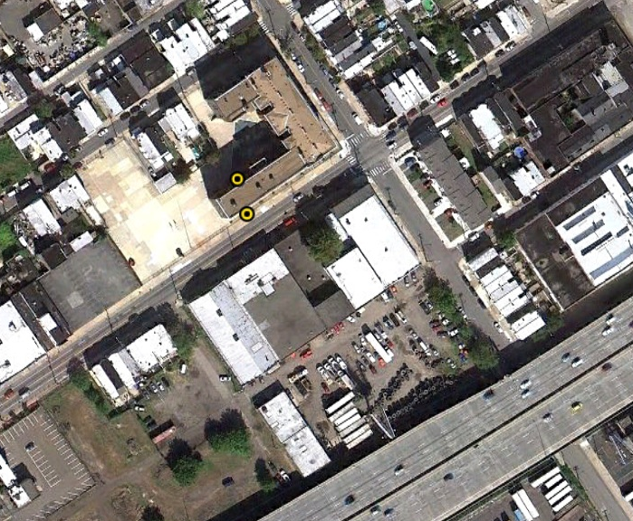
AMY James Martin Middle School
I-95

Slide 20
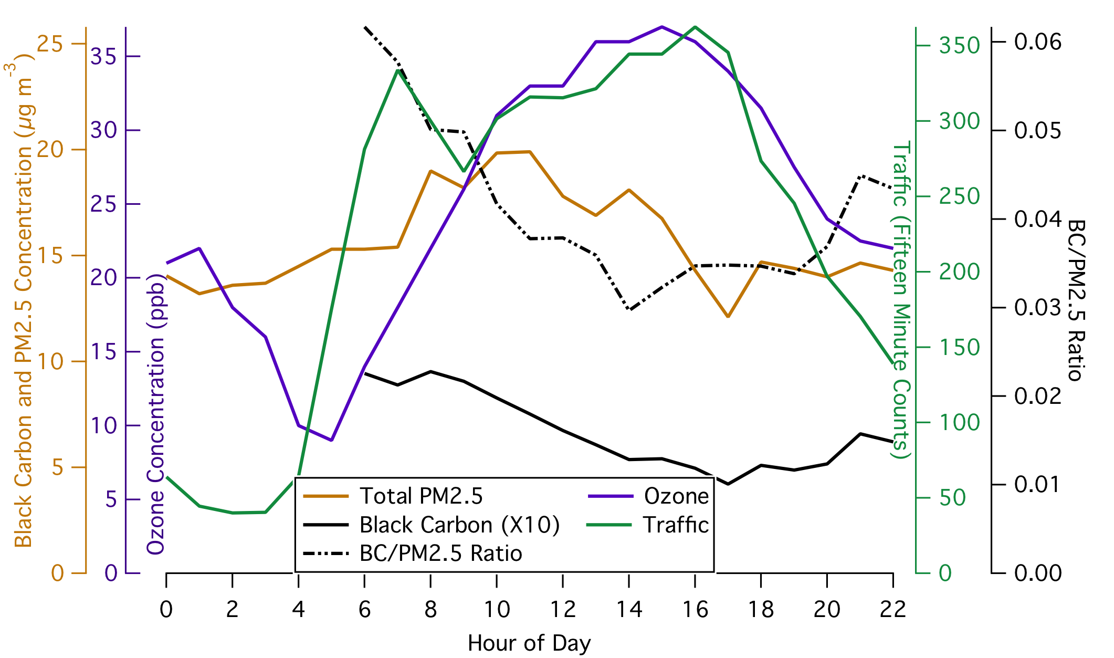
BC to PM_{2.5} Ratio*
~5% in suburban areas of N. America (Ramanathan & Crutzen, 2003)
11% & 13% in NYC (Venkatachari et al. 2006)

Slide 21
3. Black Carbon Study Results
20% decrease in median BC concentration & 37% decrease in maximum BC concentration with every 500m distance from I-95 (p=0.1)
increases in wind speed, temperature and time of day resulted in 16%, 12% and 10% decrease in hourly median BC concentration
Notes:
The results show ozone peaks in mid-day consistent with photochemical formation processes.
BC:PM2.5 ratio showed higher values in the morning when primary emissions were high. The value dropped in the afternoon when secondary aerosol formation increased consistent with other studies.

Slide 22
Road Blocks & Challenges
Technology, Equipment (& Funding)
CBPR
  How to support a community-driven process?
  Connect with a policy decision, feasible outcome

Slide 23
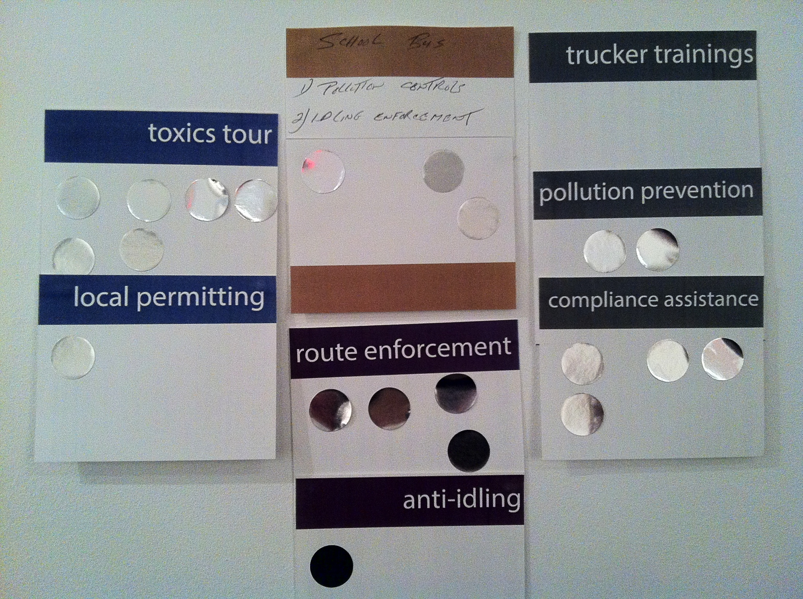
Community Reportback & Next Steps

Slide 24
Thanks & Sources
Port Richmond residents; Clean Air Council; Drs. Igor Burstyn & Hernando Perez, Drexel School of Public Health; Drs. Peter DeCarlo & Michael Waring, Drexel Dept. of Civil Engineering; Dr. Jonathan Levy (Boston University School of Public Health), Philadelphia Air Management Services; Delaware Valley Regional Planning Commission.
This work was supported in part by a grant with the Pennsylvania Department of Health. The Department of Health specifically disclaims responsibility for any analyses, interpretations, or conclusions.

